Slide 1
SECURE DATA HIDING IN IMAGES USING STEGANOGRAPHY
CAPSTONE PROJECT
Presented By: B. Swathi Lakshmi
Student Name : B. Swathi Lakshmi
College Name & Department : Geethanjali Institute Of PG Studies, MCA

Slide 2
OUTLINE
Problem Statement
Technology used
Wow factor
End users
Result
Conclusion
Git-hub Link
Future scope

Slide 3
Problem Statement
Steganography hides secret messages within regular digital files(images), making them less detectable. My project is about developing a system to embed and extract these hidden messages in images without compromising quality. The goal is to ensure the hidden information remains undetectable to unauthorized parties. Success will be measured by the system's security, capacity, and invisibility.

Slide 4
Technology used
Opencv library for CV2 in python
OS Libraries
Numpy libraries
String Libraries

Slide 5
Wow factors
Converting normal image to Encrypted image
Hiding secretive information in simple images
Non – disruption of images in the process of encryption or decryption
Using two separate codes for Encryption and Decryption

Slide 6
End users
Corporate companies sharing confidential information
Military personnel
Investigative Journalists sharing highly confident information.
Public or Private Security personnel

Slide 7
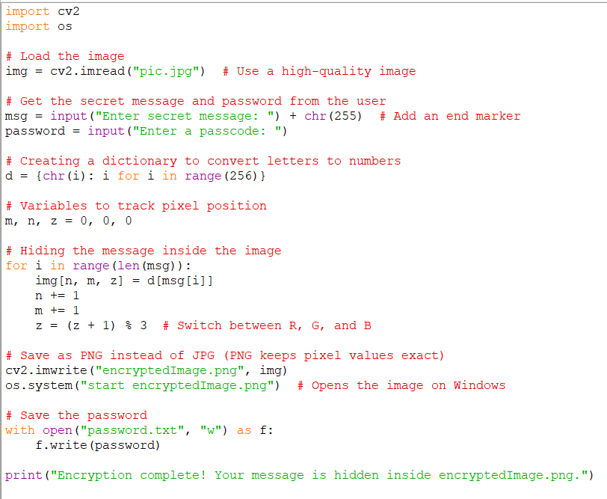
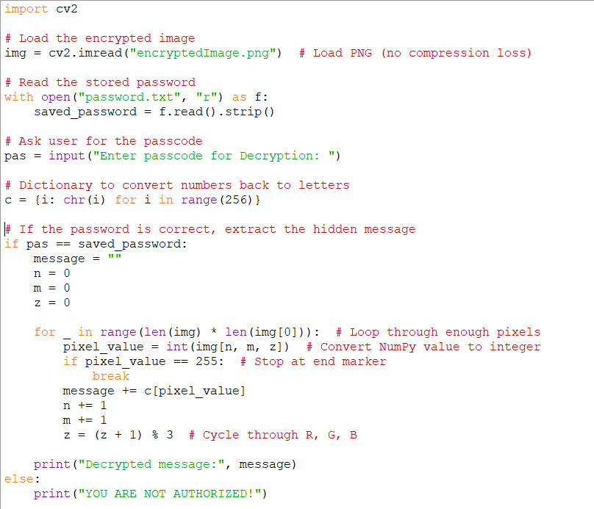

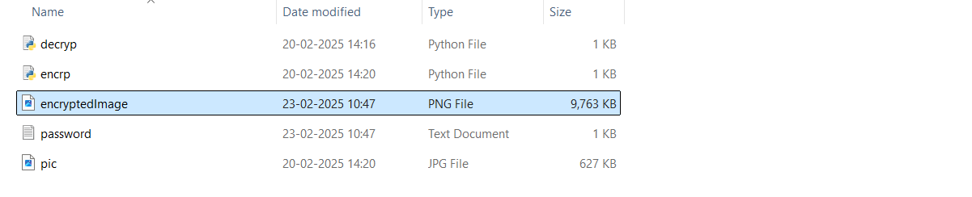
Results

Slide 8
Conclusion
I had achieved desired result by creating two separate codes for encryption and decryption of steganography project.

Slide 9
GitHub Link
https://github.com/myprojects230225/myproject_swathi

Slide 10
THANK YOU

